Slide 1


Module 4. Lesson 1.
Basics of image processing
Link to guidelines

Slide 2

Module 4. Lesson 1. Basics of image processing
Discussion:
Image processing

Slide 3


Developers, we have a new order!
The ProTeam specialists were approached by a representative of the Ministry of Social Development. He is preparing a software package for the elderly people.
It should include simple and useful applications for both experienced users and people with poor computer skills.
One of the applications should be Easy Editor.
Let's study the technicals specifications in more detail!
Discussing
work tasks
Cole,
senior developer

Slide 4
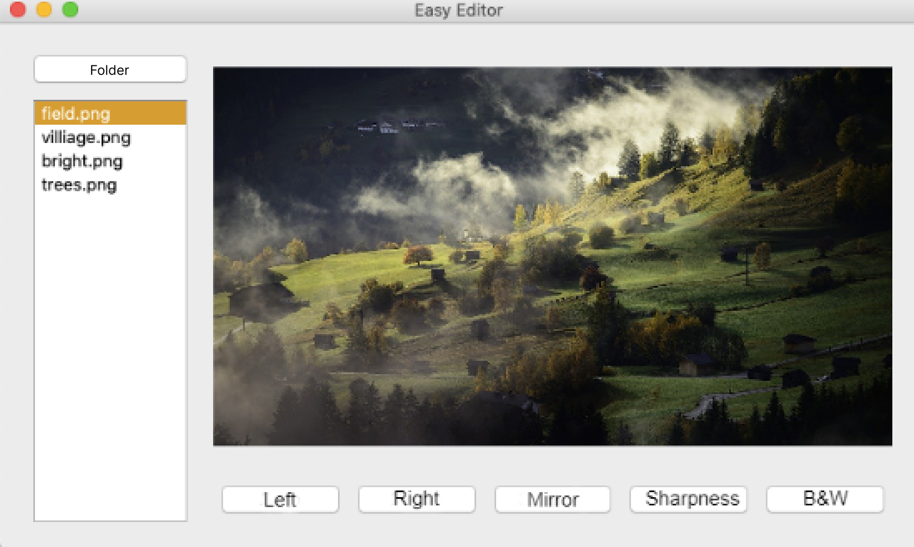
Let’s consider a possible solution
Examine the picture. What features should a photo editor have?
Discussing
work tasks

Slide 5
Let’s consider a possible solution
The Easy Editor photo editor should be able to:
Process one or more images from a folder
Discussing
work tasks
Rotate the picture left or right 90 degrees
Display the mirror image
Sharpen the image
Make the picture black and white

Slide 6
Planning our work on the project
You know two work planning tools:
mind maps and checklists.
Let's start composing a mind map:
?
Discussing
work tasks
Photo editor
?

Slide 7
Planning our work on the project
You know two work planning tools:
mind maps and checklists.
Let's start composing a mind map:
Interface development
What Python tools will we need?
Will we need to study new libraries?
Discussing
work tasks
Photo editor
Functionality

Slide 8
The goal of the work day is
to explore the PIL image processing library and prepare for the Photo Editor project.
Today you will:
Discussing
work tasks
explore the capabilities of the PIL library for photo processing;
recall the object-oriented approach to programming;
program your own ImageEditor class for photo processing.

Slide 9

Module 4. Lesson 1. Basics of image processing
Qualifications

Slide 10
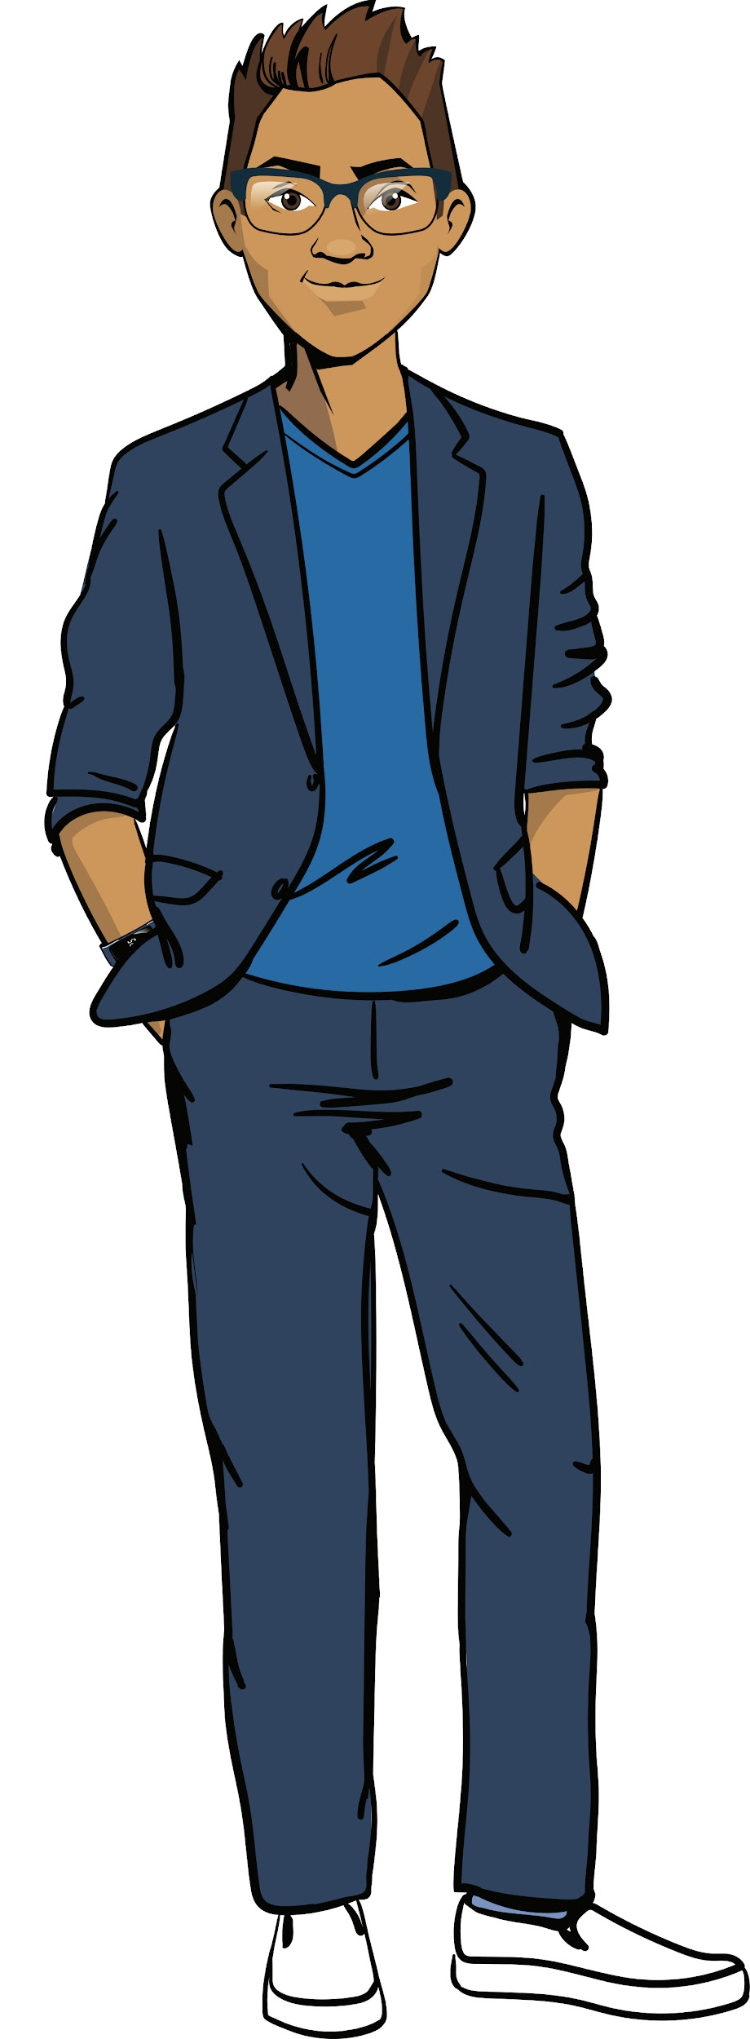
Demonstrate your knowledge
of working with files and
object-oriented programming
Qualifications

Slide 11
Which command opens a text file for reading?
When will that file be closed?
Qualifications

Slide 12
Open a text file for reading
Command | Purpose
with open("f.txt", "r") as file: | Open a text file from the project folder for reading
Qualifications
The file will be closed automatically after executing a block of commands described inside with... as...

Slide 13
What is an object?
Name at least three examples of objects from the programming world.
Qualifications

Slide 14
An object
it is a collection of data and actions that is easy to perceive as a whole.
Object 1
Object 2
Object 3
DATA
DATA
DATA
Qualifications
ACTIONS
ACTIONS
ACTIONS
Turtle:
Appearance,
Speed, etc.
Move to a distance, etc.
Application window:
Height,
Title, etc.
Show the window.
Hide the window.
Text file:
Extension,
Volume, etc.
Open,
Add data, etc.

Slide 15
What is a property?
What is a method?
Task.
You are given a piece of code. What are the names of the objects and their types? List the properties and methods provided in the program.
Qualifications
btn_OK = QPushButton('Answer')
btn_OK.setText('Next question')
window = QWidget()
window.setLayout(layout_card)
window.setWindowTitle('Memory Card')
window.show()

Slide 16
A property
is a variable inside an object.
A method
is a function inside an object.
Task.
You are given a piece of code. Name the objects and their types. List the properties and methods provided in the program.
Qualifications
btn_OK = QPushButton('Answer')
btn_OK.setText('Next question')
window = QWidget()
window.setLayout(layout_card)
window.setWindowTitle('Memory Card')
window.show()

Slide 17
What is a class?
How do you create your own class?
Qualifications

Slide 18
A class is
a single name for many objects;
in programming: a general description of how these objects should be arranged.
Classes
Qualifications
Ready-made
Your own
Already described in libraries
The properties and methods need to be described

Slide 19
Creating classes
To create a class, we need to do the following:
List in the constructor the properties that define the characteristics of an instance of the class;
list the methods for managing an instance.
class Application():
def __init__(self, title_text):
self.title = title_text
def print_info (self):
Class name
A special constructor function that creates an instance of a class with the specified properties.
Qualifications
Value
Property name
Value
Method name
Action with object and properties
__init__
Action with object and properties
Two underscores.

Slide 20
Qualifications confirmed!
Great, you are ready to brainstorm and work on your tasks!
Qualifications

Slide 21

Module 4. Lesson 1. Basics of image processing
Brainstorming:
Image processing
with PIL

Slide 22
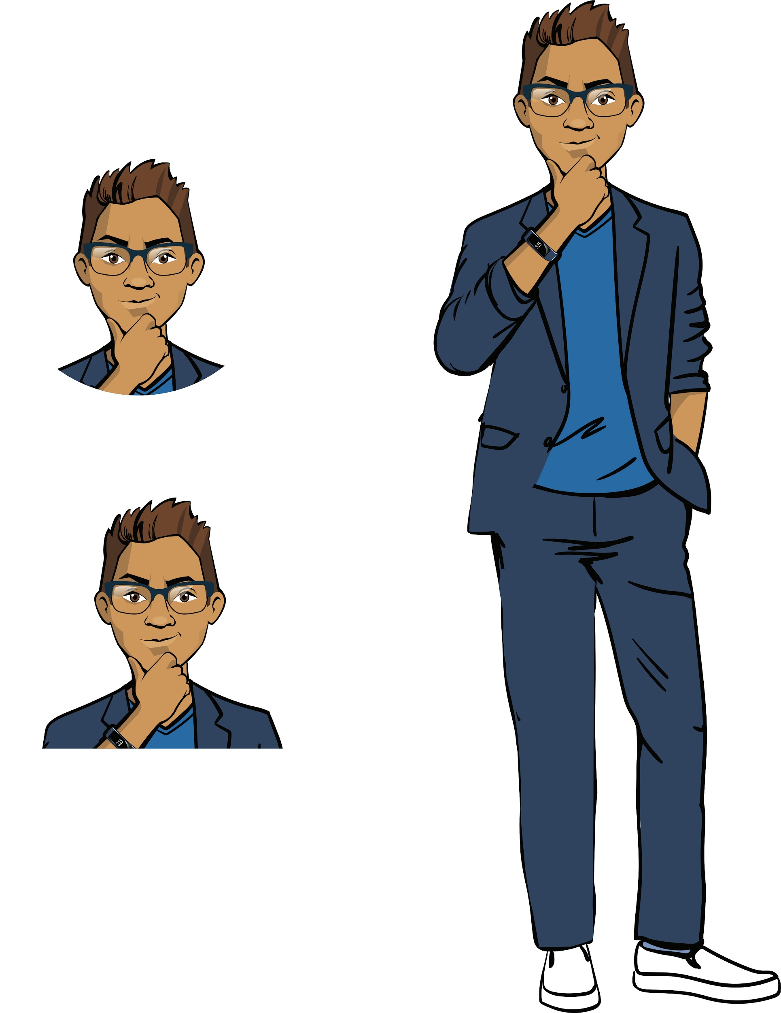
Working with images
Let's recall what raster graphics are and start exploring the PIL library for working with images.
(Python Imaging Library).
Brainstorming

Slide 23


A pixel is
a minute (indivisible) part of a graphic image
Raster is a set of pixels.
A raster image is a collection of dots (pixels) used to display a picture on a computer screen.
You worked with raster graphics in the turtle module
Brainstorming

Slide 24
The Python Imaging Library (PIL)
is a library for working with raster graphics
The PIL library has a hierarchical structure.
We'll need two modules from the framework base: Image and ImageFilter.
Image
ImageFilter
. . .
Brainstorming
The Image class:
properties and methods of working with pictures like files
The ImageFilter module:
A set of constants for applying filters and rotating and flipping images

Slide 25
Open an image to work with
To get a picture to work with, we need to import the Image module of the PIL library and open the file using the open() method and with... as operators.
Command | Purpose
from PIL import Image | Import the Image module from the PIL library
with Image.open('photo.jpg') as original: #or my_image = Image.open('photo.jpg') | Open a graphic file from the project folder
original.show() | Open the image in a separate window
Brainstorming

Slide 26
Image options
The resulting Image object has a number of properties.
Command | Purpose
original.size | File size (a pair in "length, width")
original.format | File format (jpg, png, bmp, etc.)
original.mode | File color type (color, black and white)
Brainstorming

Slide 27
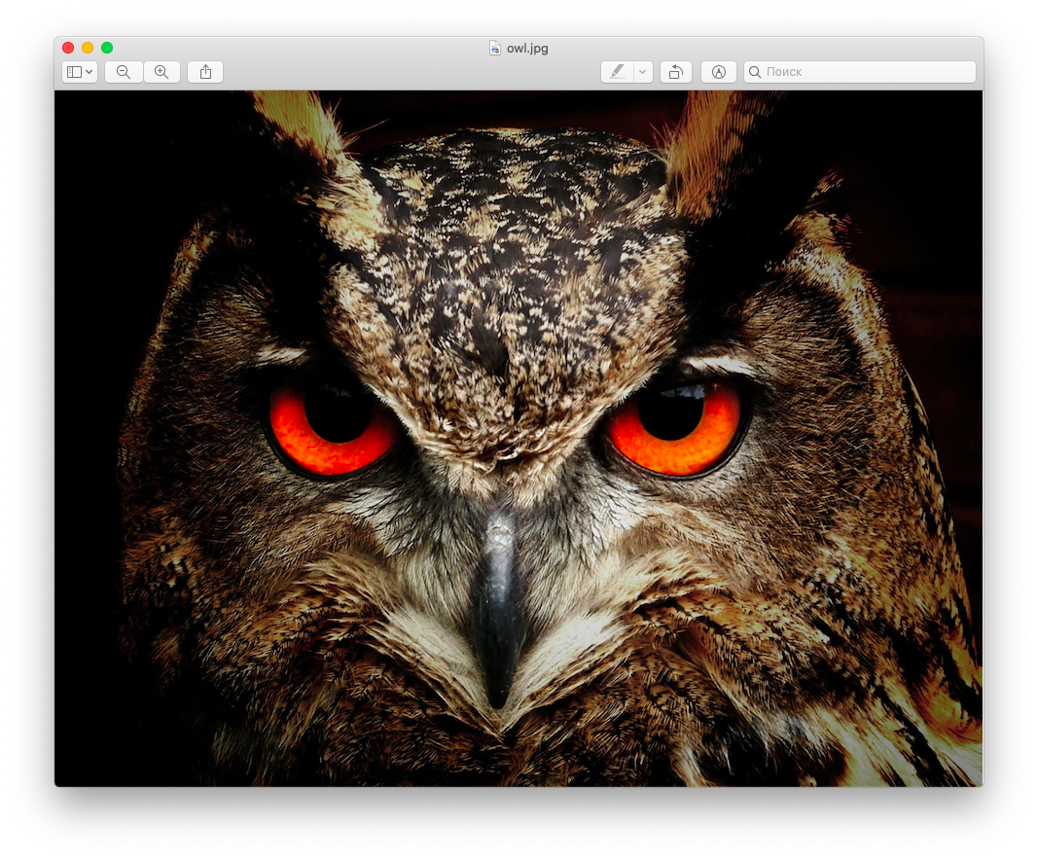
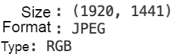
Let’s look at the task
Task. In the project folder there is a photo called owl.jpg. Write a program that displays the properties of the image to the console and opens it in a separate window.
Brainstorming
How do we solve the task?

Slide 28
Let’s look at the task
Task. In the project folder there is a photo called owl.jpg. Write a program that displays the properties of the image to the console and opens it in a separate window.
from PIL import Image
with Image.open('owl.jpg') as pic_original:
print('Size:', pic_original.size)
print('Format:', pic_original.format)
print('Type:', pic_original.mode)
pic_original.show()
Brainstorming

Slide 29
Image processing
An object of the Image class can be modified using the methods and constants of the ImageFilter module.
Command | Purpose
from PIL import ImageFilter | Import the module with filters
pic_gray = original.convert('L') | Make the image black and white
pic_blured = original.filter(ImageFilter.BLUR) | Blur the image
pic_up = original.transpose(Image.ROTATE_90) | Rotate image left 90 degrees
pic_gray.save('gray.jpg') | Save the image in your project folder with the name gray.jpg
Brainstorming

Slide 30
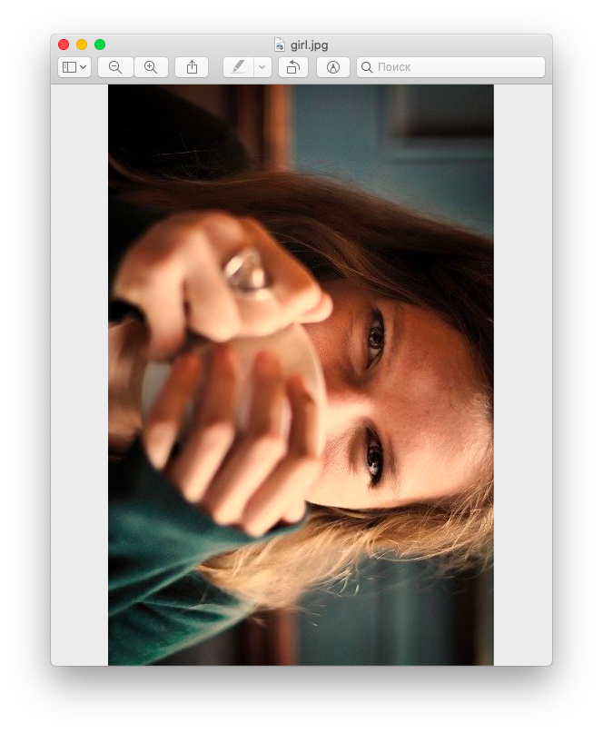
Let’s look at the task
Task. In the project folder there is a photo called girl.jpg. Write a program that rotates the picture to the left 90 degrees and makes it black and white.
Brainstorming
How do we solve the task?

Slide 31
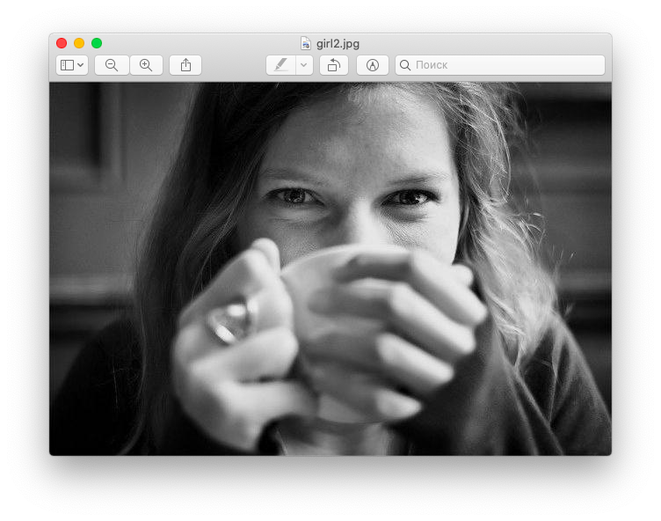
Let’s look at the task
Task. In the project folder there is a photo called girl.jpg. Write a program that rotates the picture to the left 90 degrees and makes it black and white.
from PIL import Image
from PIL import ImageFilter
with Image.open('girl.jpg') as pic_original:
pic_original.show()
pic_gray = pic_original.convert('L')
pic_gray.save('girl1.jpg')
pic_gray.show()
pic_up = pic_gray.transpose(Image.ROTATE_90)
pic_up.save('girl2.jpg')
pic_up.show()
Brainstorming

Slide 32
Conclusions:
Image processing is performed using the tools of the PIL library.
The Image module contains commands for:
getting a picture,
opening it in a separate window,
saving it under a new name,
image processing by means of ImageFilter,
accessing the picture options.
The ImageFilter module contains constants for image processing.
Brainstorming

Slide 33

Module 4. Lesson 1. Basics of image processing
Platform:
Basics of image processing

Slide 34




Complete the tasks in VS Code
"Graphics: classes"
Visual Studio Code
Working
on the platform

Slide 35
Module 4. Lesson 1. Basics of image processing
Brainstorming:
Image processing
with PIL

Slide 36
Class for image processing
Linear processing wouldn’t be very inconvenient when working with a lot of photos.
I suggest creating our own class with methods that process images.
Brainstorming
Cole,
senior developer

Slide 37
The ImageEditor class
Let's create an ImageEditor class with the following fields and methods:
Original file name
Constructor
Read original (Image object)
List of edited photos (Image objects)
Brainstorming
ImageEditor class
Upload photo
Methods
Make photo b/w
Crop photo
. . .

Slide 38
Loading an image to work with
When working with multiple files, there is another way to load images. Compare:
Before:
with Image.open('original.jpg') as pic_original:
pic_original.show()
Other way:
Brainstorming
try:
original = Image.open('original.jpg')
except:
print('File not found!')
Simplified versions without the object-oriented approach.

Slide 39
Loading an image to work with
When working with multiple files, there is another way to load images. Compare:
Before:
with Image.open('original.jpg') as pic_original:
pic_original.show()
Other way:
Brainstorming
try:
original = Image.open('original.jpg')
except:
print('File not found!')
We will use this method when creating ImageEditor.
Simplified versions without the object-oriented approach.

Slide 40
The ImageEditor class
Let's start creating a class with a constructor and a method for loading an image.
The class fields have already been defined by the senior developer.
class Application():
def __init__(self, title_text):
self.filename = filename
self.original = None
self.changed = list()
def open(self):
?
?
By default, there is nothing there. Later we will add a link to the uploaded original
Brainstorming
?
?

Slide 41
The ImageEditor class
Let's start creating a class with a constructor and a method for loading an image.
The class fields have already been defined by the senior developer.
class Application():
def __init__(self, title_text):
self.filename = filename
self.original = None
self.changed = list()
def open(self):
?
?
ImageEditor class fields:
- file name (photo.jpg);
- link to original photo;
- list of modified copies of the original.
Brainstorming
?
?
What words should be in the blanks? Why?
. . .

Slide 42
class ImageEditor():
def __init__(self, filename):
self.filename = filename
self.original = None
self.changed = list()
def open(self):
try:
self.original = Image.open(self.filename)
except:
print('File not found!')
self.original.show()
Brainstorming

Slide 43
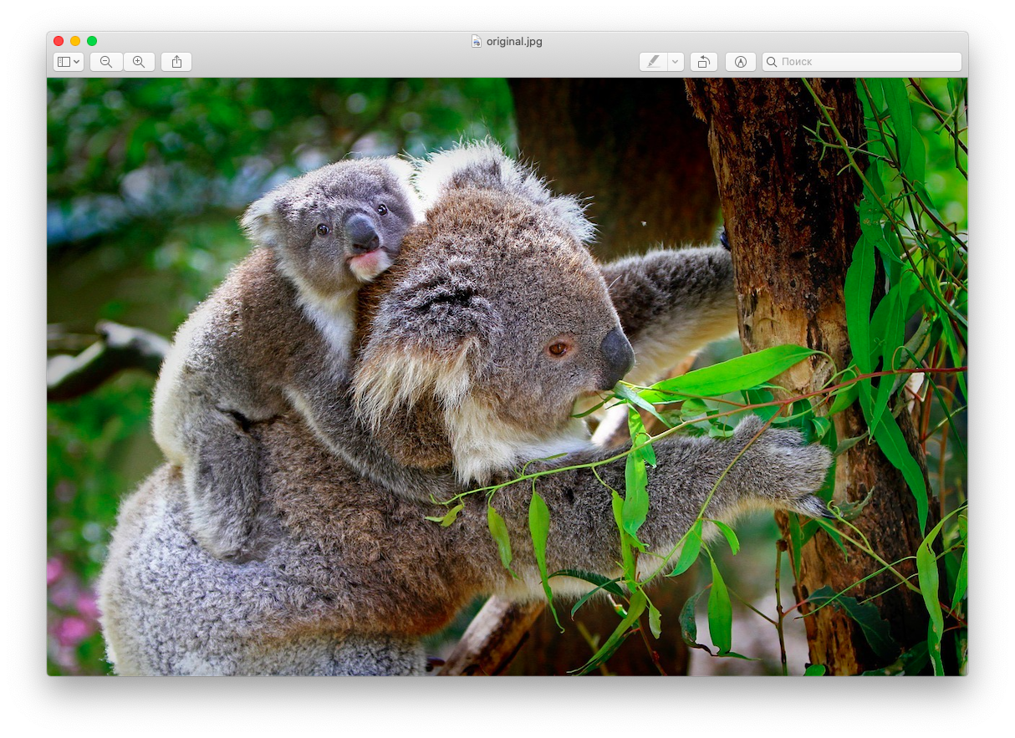
Let’s look at the task
Task. Read from the project folder and open the file called original.jpg in a separate window. Use the ImageEditor class.
Brainstorming
How do we solve the task?

Slide 44
Possible solution
from PIL import Image
class ImageEditor():
def __init__(self, filename):
self.filename = filename
self.original = None
self.changed = list()
def open(self):
try:
self.original = Image.open(self.filename)
except:
print('File not found!')
self.original.show()
MyImage = ImageEditor('original.jpg')
MyImage.open()
Brainstorming

Slide 45
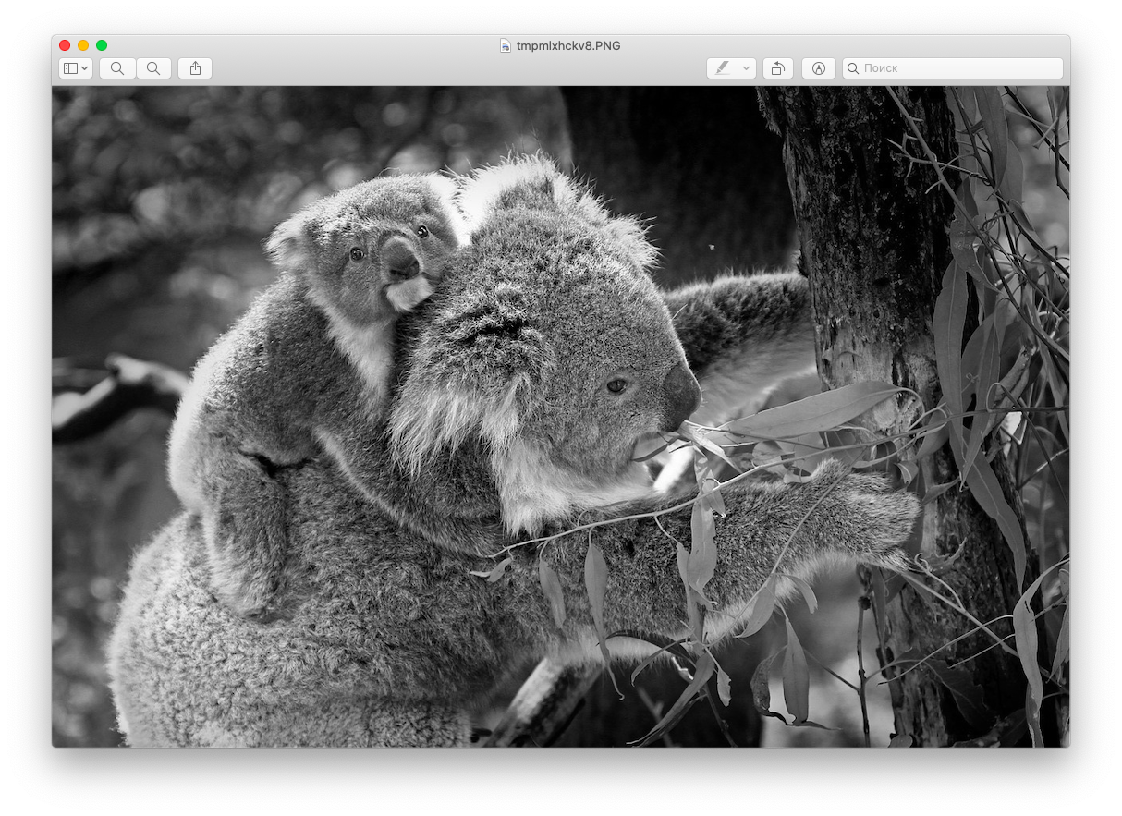
Let’s look at the task
Task. Process the original image: make it black and white. Program the processing as a method of the ImageEditor class.
Brainstorming
How do we solve the task?

Slide 46
Possible solution
from PIL import Image
from PIL import ImageFilter
class ImageEditor():
def __init__(self, filename):
#body of the class constructor
def open(self):
#body of the "load image" method
def do_bw(self):
gray = self.original.convert("L")
self.changed.append(gray)
gray.save('gray.jpg')
MyImage = ImageEditor('original.jpg')
MyImage.open()
MyImage.do_bw()
Brainstorming

Slide 47
Before we continue:
How could we process a picture differently, for example, blurring it? How will the ImageEditor class change?
Suppose we want to make two pictures black and white with the names cat.jpg and dog.jpg.
How do we supplement the main part of the program?
Brainstorming

Slide 48
Module 4. Lesson 1. Basics of image processing
Platform:
Image processing
using classes

Slide 49
Complete the tasks in VS Code
"Graphics: basics"
Visual Studio Code
Working
on the platform

Slide 50

Module 4. Lesson 1. Basics of image processing
Wrapping up
the work day

Slide 51

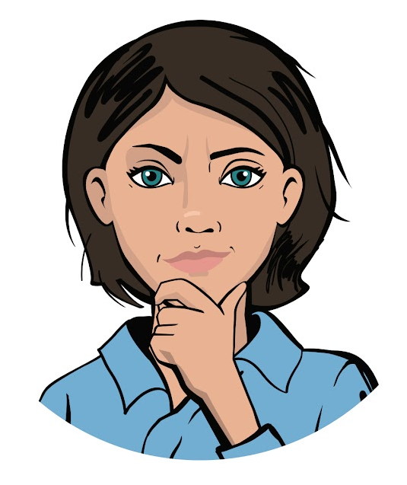
Let’s wrap up the work day by answering these technical questions:
Which library contains image processing tools? What modules does it have?
What image processing methods do you know?
What is a class? What is the advantage of processing images with the ImageEditor class?
Wrapping up
the work day
Cole,
senior developer
Emily,
project manager

Slide 52
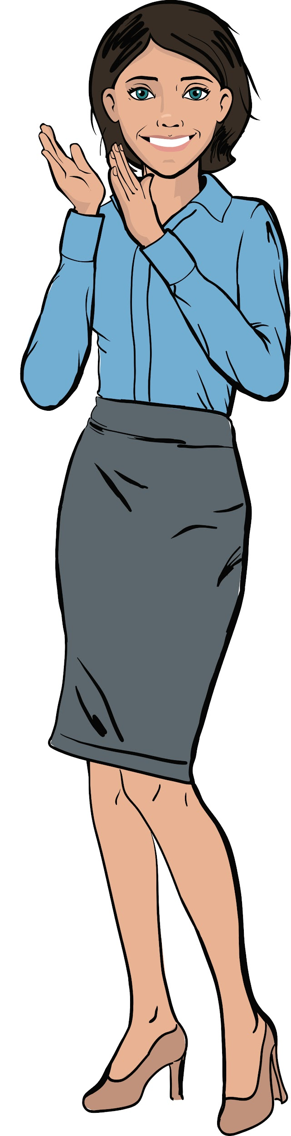
Excellent work!
Colleagues,
Today you learned the basics of working with raster graphics using Python.
On our next work day, we will be able to start creating the "Photo Editor" application!
Wrapping up
the work day

Slide 53
Task to improve efficiency
Bonus work tasks
VS Code
Summing up
the work day

